Slide 1



Introduction to Machine Learning and Deep Learning
Machine learning and deep learning are transformative technologies that are revolutionizing industries and unlocking new possibilities. This presentation will provide an overview of these exciting fields, exploring their core concepts, applications, and the future of AI.
by precious darkwa

Slide 2
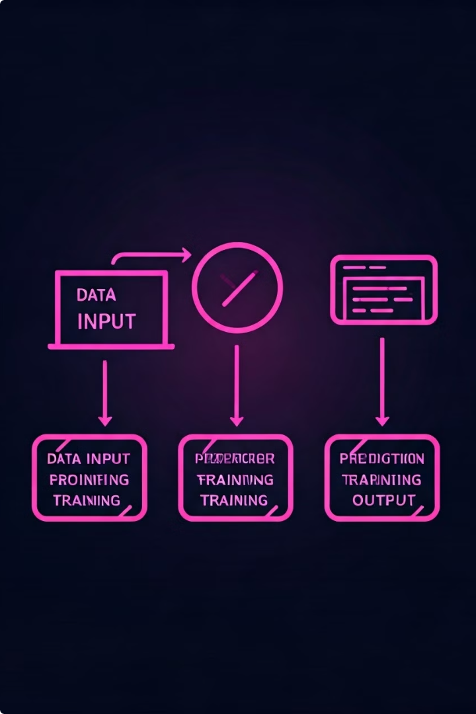
What is Machine Learning?
1
Data-Driven Algorithms
Machine learning utilizes algorithms that can learn from data, identify patterns, and make predictions without being explicitly programmed.
2
Automated Decision-Making
Machine learning models can automate complex decision-making processes, enabling intelligent systems to adapt and improve over time.
3
Diverse Applications
From image recognition to natural language processing, machine learning has a wide range of practical applications in various industries.

Slide 3
Supervised Learning
Labeled Data
Predictive Modeling
Common Tasks
Supervised learning algorithms are trained on labeled datasets, where the desired outputs are known in advance.
These models learn to map inputs to outputs, enabling them to make accurate predictions on new, unseen data.
Supervised learning is used for tasks like classification, regression, and structured prediction.

Slide 4
Unsupervised Learning
Unlabeled Data
Pattern Discovery
Clustering
Unsupervised learning algorithms work with datasets that do not have pre-defined labels or outputs.
These models aim to uncover hidden structures, relationships, and insights within the data.
A common unsupervised learning task is clustering, where similar data points are grouped together.

Slide 5
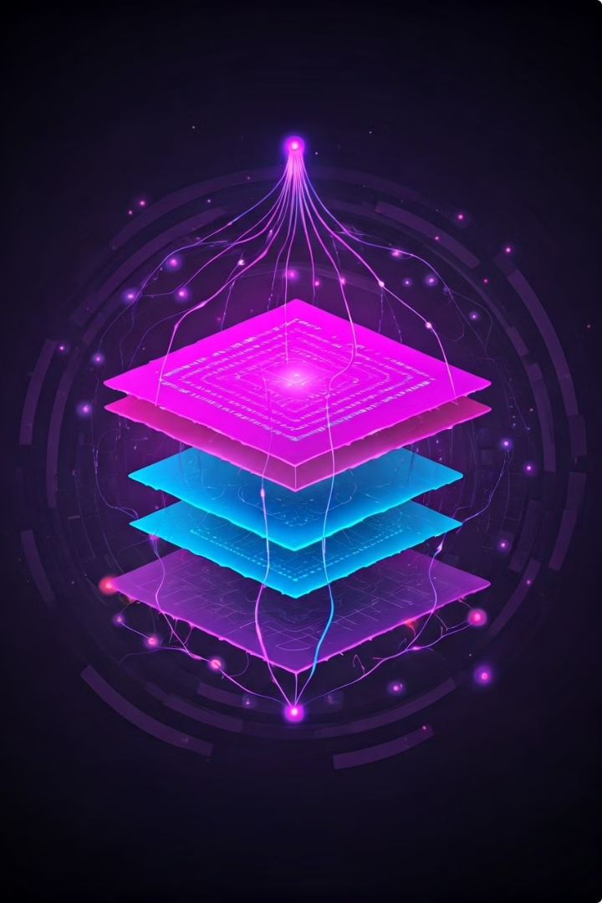
Neural Networks and Deep Learning
1
Artificial Neurons
Neural networks are inspired by the structure and function of the human brain, with interconnected nodes acting as artificial neurons.
2
Deep Architecture
Deep learning models have multiple hidden layers, allowing them to learn increasingly complex representations of the input data.
3
Powerful Learning
The depth and complexity of deep neural networks enable them to tackle challenging problems that were previously difficult to solve.

Slide 6




Applications of Machine Learning
Computer Vision
Machine learning powers intelligent image and video analysis, enabling tasks like object detection, facial recognition, and image classification.
Natural Language Processing
Machine learning algorithms can understand, interpret, and generate human language, enabling applications like chatbots, language translation, and sentiment analysis.
Predictive Analytics
Machine learning models can analyze complex data to uncover patterns and make accurate predictions, revolutionizing decision-making in fields like finance, healthcare, and business.

Slide 7

Challenges and Limitations
Bias and Fairness
Machine learning models can perpetuate societal biases if the training data is not representative or diverse.
Interpretability
The complexity of deep learning models can make it difficult to understand their decision-making processes, limiting their transparency and accountability.
Data Limitations
Successful machine learning requires large, high-quality datasets, which can be scarce or expensive to obtain for certain applications.

Slide 8




Future Trends in AI and Machine Learning
Ethical AI
Developing AI systems that are transparent, accountable, and aligned with human values will be a key priority.
Explainable AI
Advancements in interpretable machine learning models will enhance the trustworthiness and adoption of these technologies.
Multimodal Learning
The ability to integrate and learn from diverse data sources, including text, images, and audio, will drive more versatile AI applications.

